Slide 1
Field Examples
Forces Imagined

Slide 2
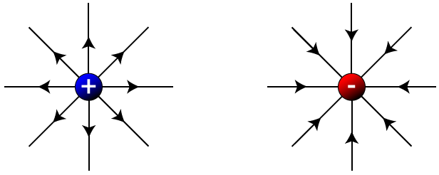
Electric Field

Slide 3
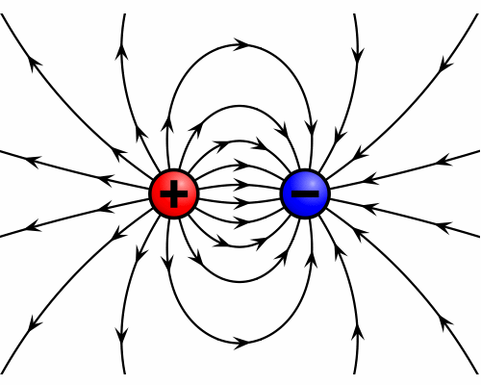
Electric Field

Slide 4
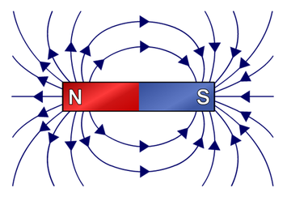
Magnetic Field

Slide 5
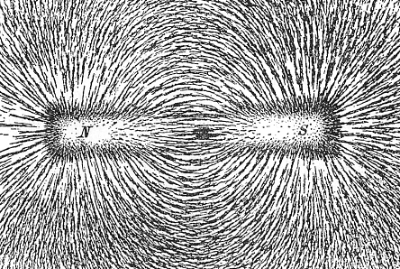
Magnetic Field

Slide 6
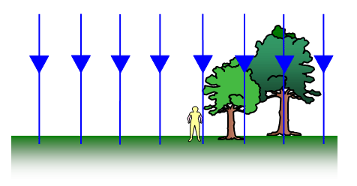
Gravitational Field

Slide 7

Gravitational Field
F_{g} = Mass of Apple x Field Strength
F_{g} = mg

Slide 8
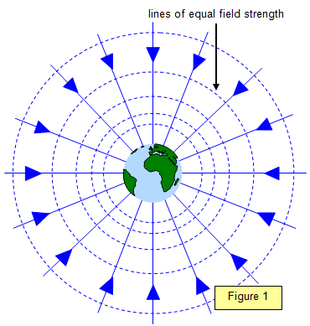
Newton’s Gravitational Field

Slide 9



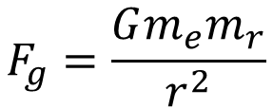
Newton’s Gravitational Field
F_{g} = Mass of Rocket x Field Strength
$$F_{g}=\frac{Gm_{e}m_{r}}{r^{2}}$$
$F_{g}=\left(\frac{Gm_{e}}{r^{2}}\right)$ $m_{r}$
$$F_{g}=g{ m}_{r}$$

Slide 10
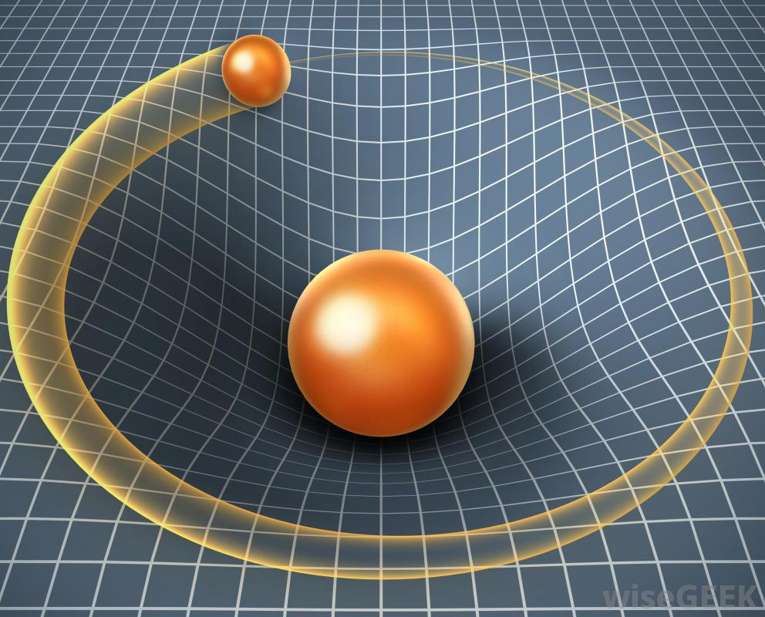
Einstein’s Gravitational “Field”
Objects of large mass warp the dimensions of space and time.
Gravity is what we observe when objects follow the warps in space and time.
Effects:
Space is curved by large masses
Time slows down near large masses

